Slide 1


English Premier League Predictions
Darion Ong Yu Jie

Slide 2


TABLE OF CONTENTS
01 INTRODUCTION 02 PROBLEM STATEMENT 03 THE DATA APPROACH 04 EXPLORATORY DATA ANALYSIS & FEATURE ENGINEERING 05 MODEL SELECTION & EVALUATION 06 PREDICTIONS 07 CONCLUSION

Slide 3


INTRODUCTION
Football is the most popular sport in the world and it is very dominant in countries from Europe, South America and Africa.
Each country have their own individual leagues and English Premier League is the top league from England.
Notable teams in league are Manchester United, Liverpool, Arsenal, Chelsea and Manchester City.

Slide 4

PROBLEM STATEMENT
Using past matches stats and football team stats from FIFA , predict future matches results.
Approach :
Using ML with Multi-Class Classification, discover important features for predicting the match results and develop a model which can assist potential stakeholders such as football pundits, betting website, football fans and shareholders of football club.

Slide 5
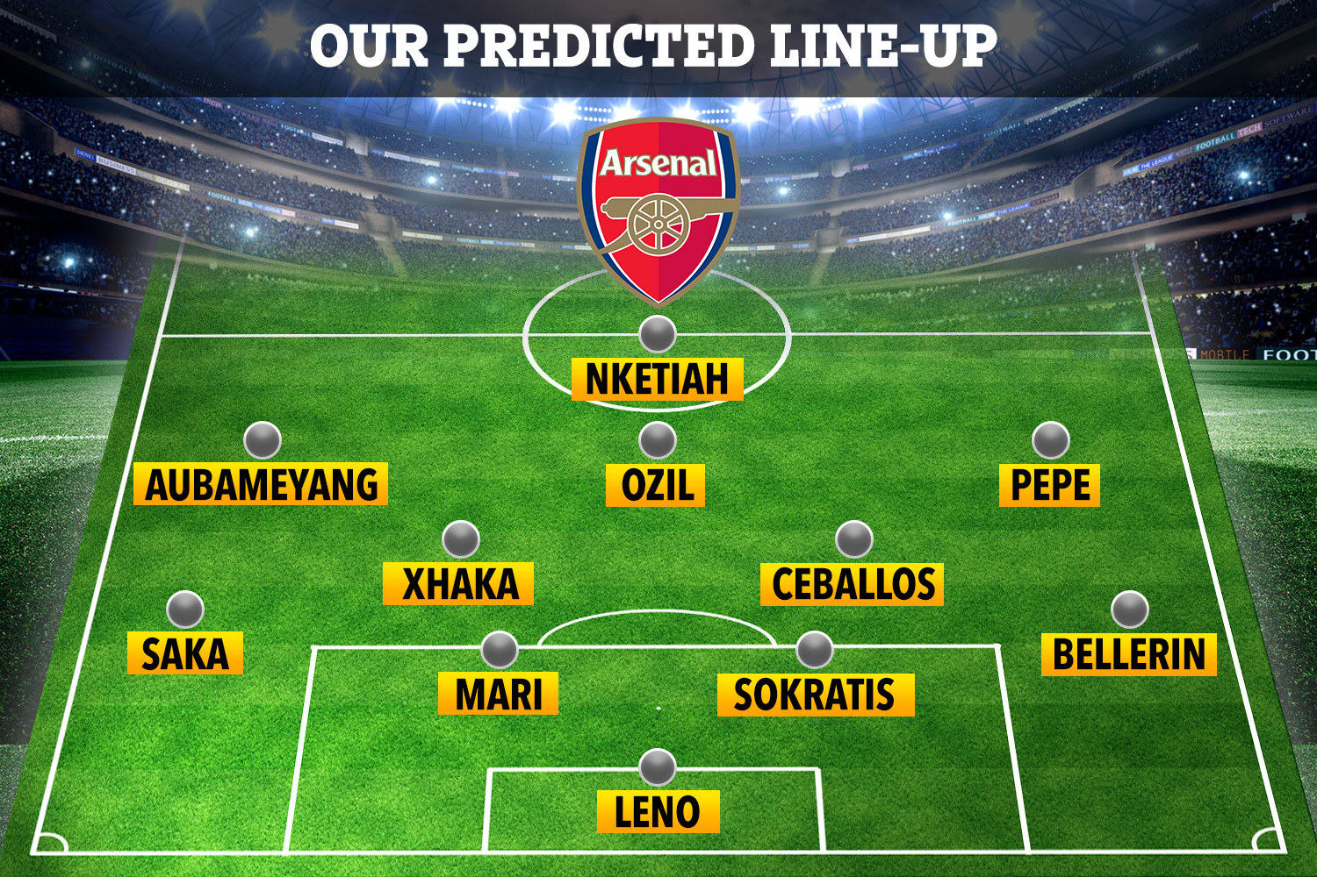


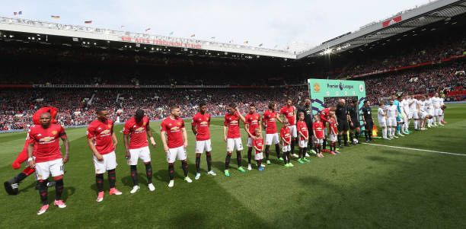
THE DATA APPROACH
Chosen players’ stats are then taken from the FIFA stats to form team stats.
FIFA18, 19, 20 & 21 datasets taken from Kaggle
I
II
III
IV
Web Scrap Data for the following seasons: 2017/2018, 2018/2019 2019/2020, 2020/2021
Using the seasons fixtures data, locate 18 players with the most appearance in each team for each season.

Slide 6
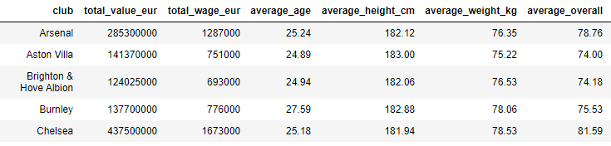
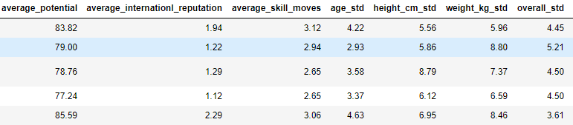
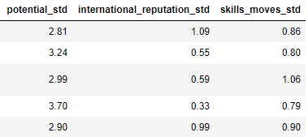
EXPLORATORY DATA ANALYSIS & FEATURE ENGINEERING Team Statistics Features
As mentioned in previous slide, the team stats are engineered from top 18 players with the highest appearances in the season.
The stats used from each player are Value, Wages, Age, Height, Weight, Overall, Potential, International Reputation and Skills Move.
Different features are engineered differently: - Wage and Value are summed. -Mean and Standard Deviation of Age, Height, Weight, Overall, Potential, International Reputation and Skills are used

Slide 7
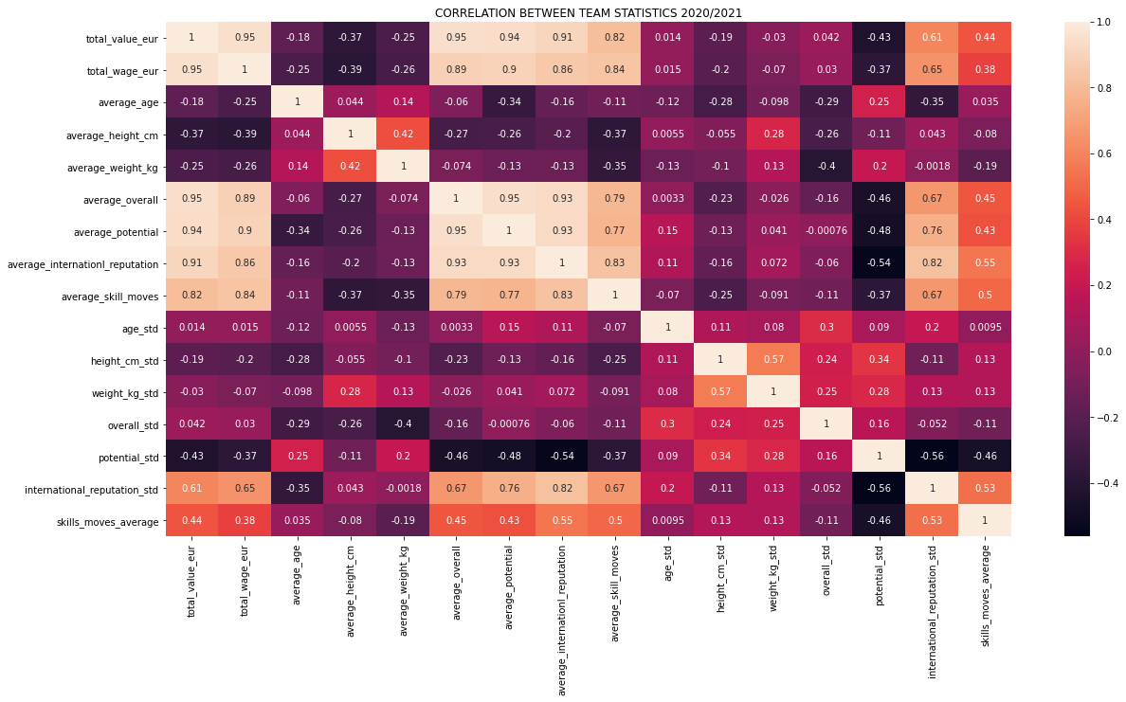
EXPLORATORY DATA ANALYSIS & FEATURE ENGINEERING Correlation Between Team Statistics
This is the heatmap of correlation between all the team stats.
As footballers tend to be more valuable if they are better, the average overall and average potential are positive correlated with value and wages.
However, as a footballer ages, they tend to be not as good as before, their value, potential, overall and wages will drop.
Therefore, age has a strong negative correlation with a lot of other features.

Slide 8
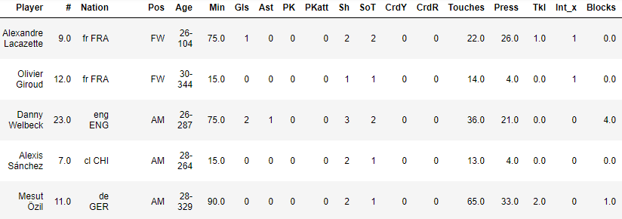
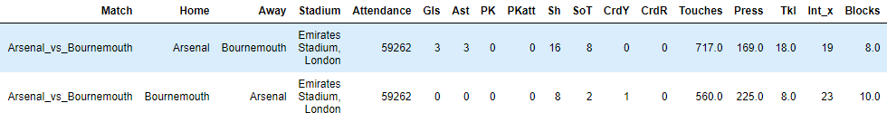
EXPLORATORY DATA ANALYSIS & FEATURE ENGINEERING Fixtures Matches Stats
One of the datasets we are using is the fixtures data, which consists of the matches that have been played in the season.
Each match has the match stats for the players, such as Gls which is goals, SoT is shots on target and CrdY is yellow card.
As we are looking at the team as a whole, we will sum up each stat from each player into one.

Slide 9
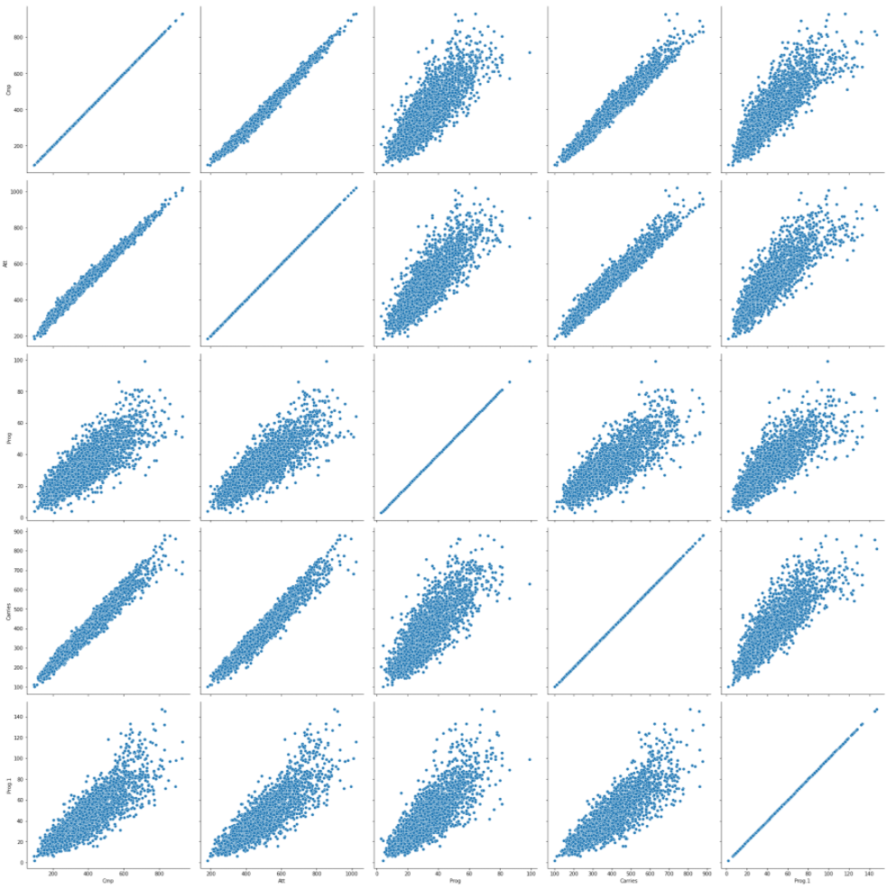
EXPLORATORY DATA ANALYSIS & FEATURE ENGINEERING Fixtures Matches Stats
Most of the features in the match stats are related.
The grid on the right contains the scatter plot for: - Passes Completed (Cmp) > 1st Row - Passes Attempted (Att) > 2nd Row - Progressive Passes (Prog) > 3rd Row - Times the team controlled the ball (Carries) > 4th Row - Progressive Carries (Prog.1) > 5th Row
Using the scatter plot, you can see the moderate to strong linear relationship between the features. These features have strong relationship.
Based on my understanding, these features are related to passes and possession. Before a pass is carried out, the ball will be at the player’s possession.

Slide 10
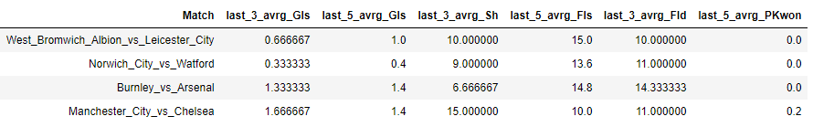
EXPLORATORY DATA ANALYSIS & FEATURE ENGINEERING Past Matches Stats
As we will not know future matches stats as the match will not been played, we will engineer the last three games and last five games average to determine the future.

Slide 11
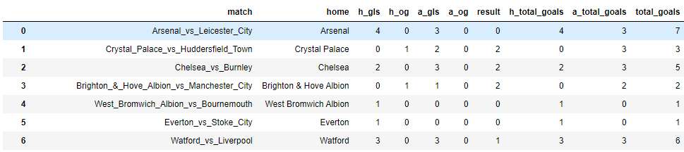
EXPLORATORY DATA ANALYSIS & FEATURE ENGINEERING Result & Match Goals
There is no result feature. Therefore, create using the goals and own goals stats.
The values will be as followed: 0 is Home Win, 1 is Draw and 2 is Away Win.
The home goals feature does not include the away own goals and is the same for the away goal feature.
Three new features were created, Home Total Goals, Away Total Goals and Total Goals.

Slide 12
EXPLORATORY DATA ANALYSIS & FEATURE ENGINEERING Combination of Fixtures and Team Stats
After all necessary features are sorted, we combined the fixtures and team stats accordingly to the seasons they played in.
Each season is ranged between two dates based on the table on the right
Season 2020/2021 is currently ongoing.
 | Start Date | End Date
Season 2017/2018 | 2017-08-09 | 2018-05-13
Season 2018/2019 | 2018-08-09 | 2019-05-13
Season 2019/2020 | 2019-08-08 | 2020-07-27
Season 2020/2021 | 2020-09-11 | Current

Slide 13

MODEL SELECTION & EVALUATION
With our data, we will be looking at three targets.
Result
Home Total Goals
Away Total Goals

Slide 14
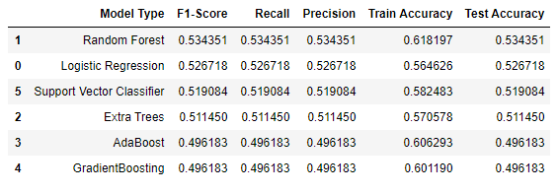
MODEL SELECTION & EVALUATION: Result
As we prepare for modeling, we have dropped rows with null values and features that are not so related to Result.
F1 Score is used as the determinant metric. Micro Average is used as the data is not balanced.
Random Forest is chosen.

Slide 15
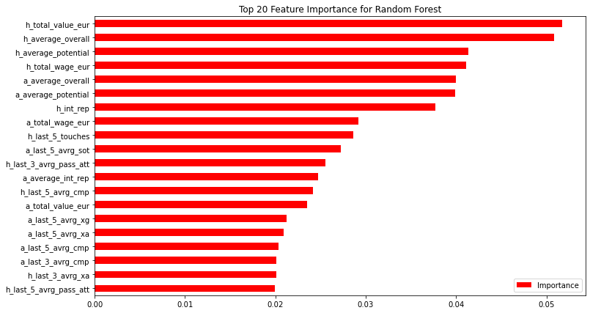
MODEL SELECTION & EVALUATION: Result
Using Random Forest, most of the features that are important are individual team stats.

Slide 16
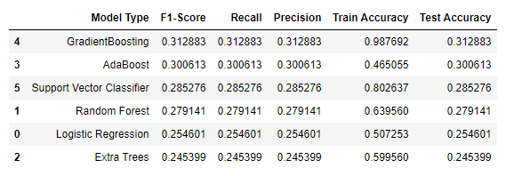
MODEL SELECTION & EVALUATION: Home Total Goals
Similarly, we will drop null values and features not very correlated to Home Total Goals. There are a total of 9 classes. However, we remove 2 of them as there are only two matches in it.
The data is still very imbalanced, so they are SMOTE before being trained.
F1 Score is used as the determinant metric. Micro Average is used as the data is not balanced. However, the test accuracy is lower than the base line.
Gradient Boosting is chosen.

Slide 17
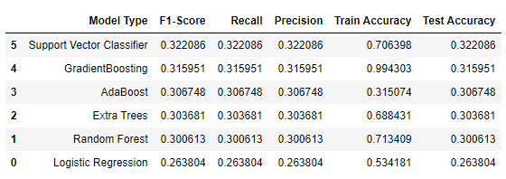
MODEL SELECTION & EVALUATION: Away Total Goals
Similarly, we will drop null values and features not very correlated to Away Total Goals. There are also a total of 9 classes. However, we remove 2 of them as there are only two matches in it.
The data is still very imbalanced, so they are SMOTE before being trained.
F1 Score is used as the determinant metric. Micro Average is used as the data is not balanced. However, the test accuracy is lower than the base line.
Support Vector Classifier is chosen.

Slide 18
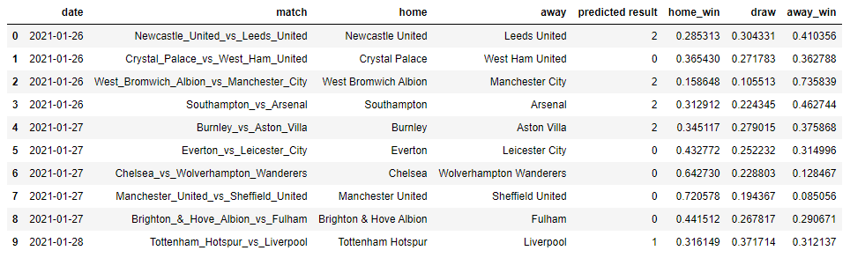
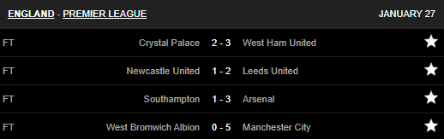
PREDICTIONS: Result Odds with Singapore Pools
To test the model, we decide to take matches that are to be played this week for predictions.
We use the current season dataset to determine the upcoming matches.
On the right is the table of matches with the predicted results and probabilities.
As some matches have just been played, the below table is the result.

Slide 19
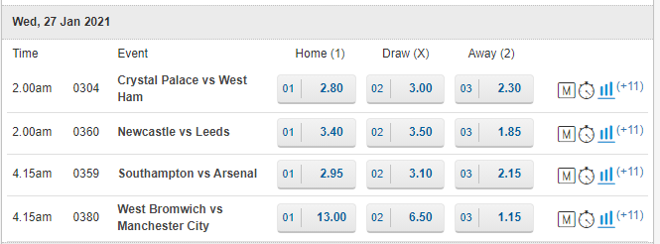
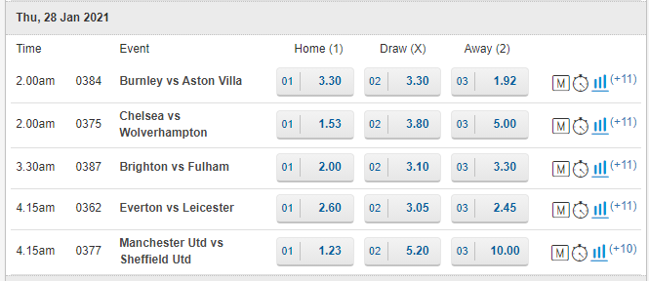
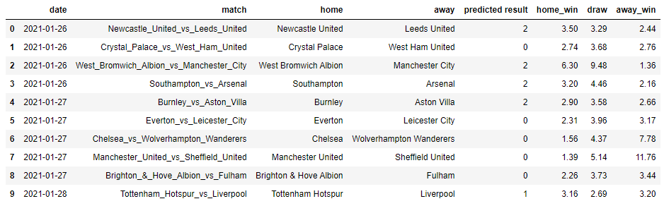
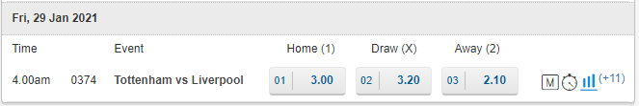
PREDICTIONS: Result Odds with Singapore Pools
Using probability, we managed to calculate the odds created from our model.
We then compared the odds to the odds by Singapore Pools. This is to see whether we think alike.

Slide 20
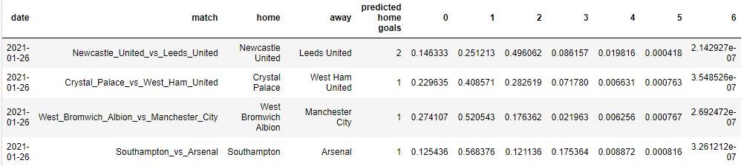
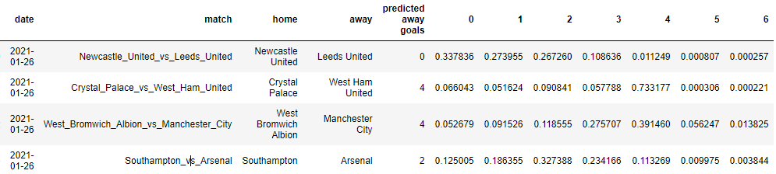
PREDICTIONS: Exact Score Prediction Using Home & Away Goals
Similarly, we also tested the home total and away total goals of the matches.
We also compare the odds created from the model and Singapore Pools’.
Notes:
All of the exact score are wrong. However, 2 out of 4 matches total goals is corrected.

Slide 21
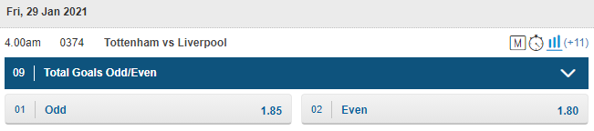
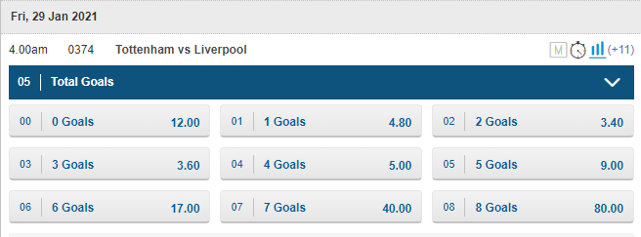
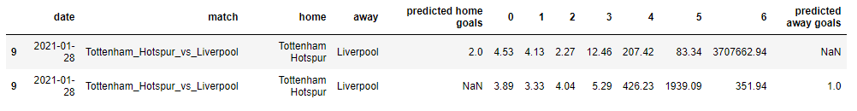
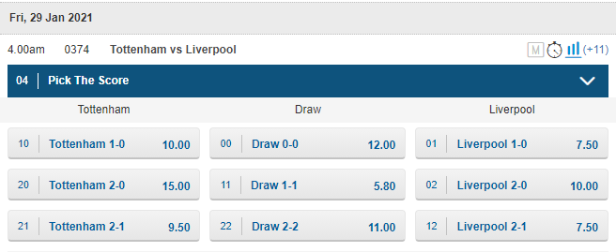
PREDICTIONS: Exact Score Prediction Using Home & Away Goals
Here we compared a match’s Home & Away Goals odds with Singapore Pools’.
With this target variable, our prediction enables betting sites to produce three different betting method.

Slide 22
CONCLUSION
Moving Forward
We are only able to get 53% accuracy and F1-Score for the Result prediction. For Home and Away Goals predictions, we are only able to get 31.2% and 32.2%. Football prediction is not as easy as it seems to be. Other factors such match-fixing, players injuries, etc, can also affect the match outcome.
More data like events during a match, players data and players to players data.
More targets can be explored.
Half-Time and Full-Time scores, which team to score first, which player to score first, number of corners,
number of yellow cards etc.

Slide 23

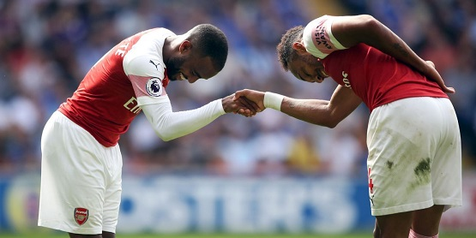
THANK YOU
Do you have any questions?
And please do not use the predictions to gamble.

Slide 24
SOURCES
English Premier League – www.premierleague.com
FBREF – www.fbref.com
EA FIFA - https://www.ea.com/games/fifa
Kaggle Dataset - https://www.kaggle.com/stefanoleone992/fifa-21-complete-player-dataset

